Slide 1

Advanced Computer Science Topics
By Alex Joslin

Slide 2
Basic (Procedural Programming)
Data Types
Variables
if-statements
switch-statements
operators
while loops
for loops
functions
arrays
multidimensional arrays
strings
Try / Catch
Exception Handling
References
Pointers
Enums
Type Casting
File Handling (reading & writing)

Slide 3
Intermediate (Object-Oriented Programming)
Classes
Objects
Constructors
Methods
Overloading
Overriding
Operator Overloading
Special Methods
Encapsulation
Inheritance
Polymorphism
Abstract classes
Interfaces
Pure Virtual Functions
Generics / Templates
Friend Classes and Functions

Slide 4
Advanced (Data Structures & Algorithms)
Data structures are methods of storing and organizing data in a computer system.
Data structures have nothing to do with data bases or performing queries with data bases.
An example of a well-known data structure is an array. Another example is a HashTable.
We me know how to use an Array or HashTable, but how do you make one by scratch?
There are many different types of data structures out there.

Slide 5

Applications of Data Structures and Algorithms
(((6 + 3) * (7 – 2)) / 5)
Dijkstra's Two-Stack Algorithm

Slide 6
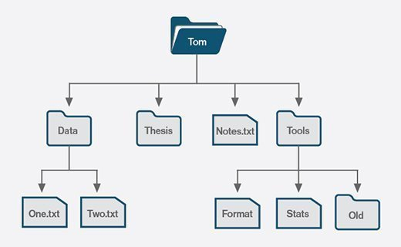
Applications of Data Structures and Algorithms
Is there a data structure for storing data
organized in a tree like structure?
Is there an algorithm for searching
an item quickly?

Slide 7

Applications of Data Structures and Algorithms
Is there a data structures for storing
relationships between nodes and edges?
Is there an algorithm to find the shortest
path between two nodes?

Slide 8

AI, ML, DL - The Intelligence of Machines

Slide 9
Artificial Intelligence
What is AI?
Artificial Intelligence is a field in computer science dedicated to creating algorithms to build intelligent agents capable of performing tasks that typically require human intelligence.

Slide 10
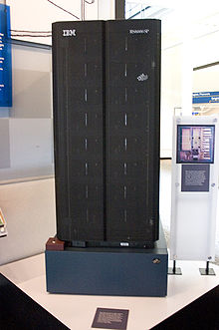

Deep Blue - 1986
vs
Garry Kasparov

Slide 11


Mancala AI

Slide 12
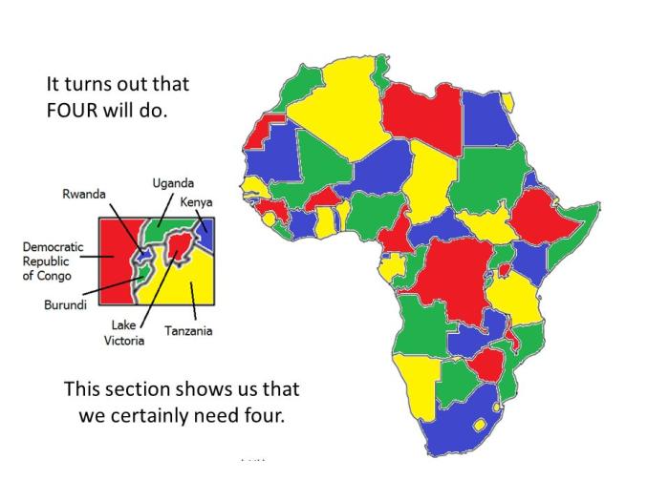
Map Coloring AI
Problem:
Figure out a way to color a map using
n # of colors given that no two adjacent
regions have the same color

Slide 13
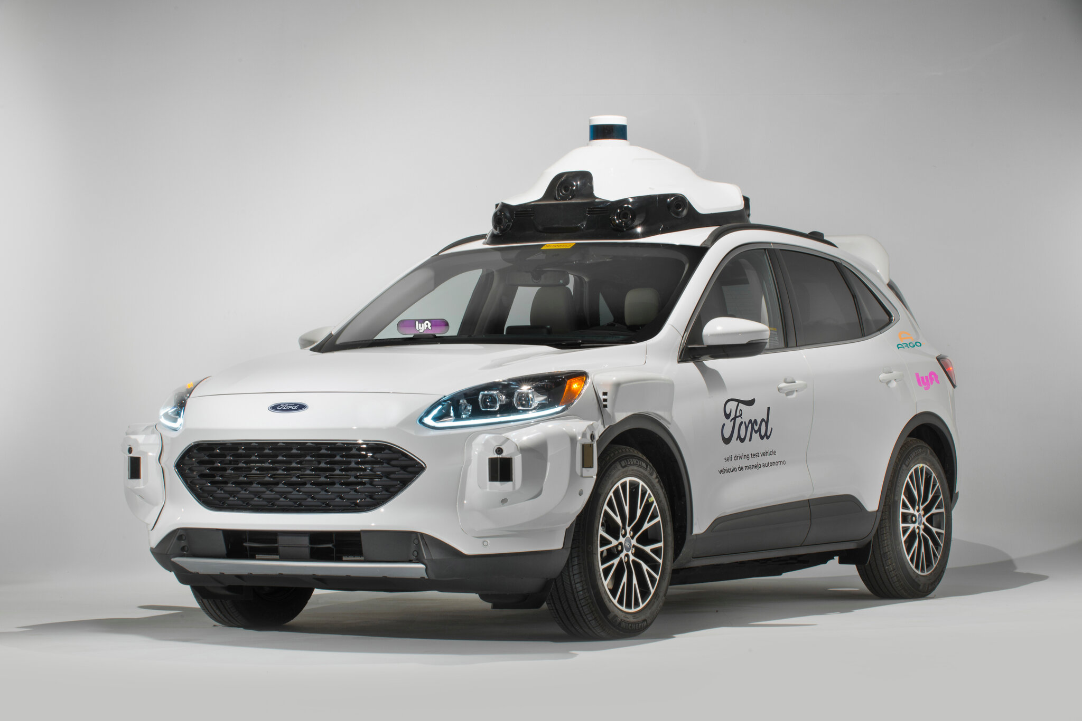
Machine Learning
It is a branch of artificial intelligence based on the idea that systems can learn from data,
identify patterns and make decisions with minimal human intervention.
Make Video Games More Realistic
Essay Writer
Face Generation
You can use ML to remove shadows from photos,
create 3d photography, read text on a picture,
turn drawings to photos, simulate civilizations
to identify the best economic tax system,
predict the future, and much more .

Slide 14
Machine learning
3 types of Machine Learning
Supervised Learning - learns based on labels
Classification, Regression
Unsupervised Learning - learns on its own
Clustering
Reinforcement Learning - learns based on environment
Gaming

Slide 15
Deep Learning
Deep learning is a type of machine learning that imitates the way humans gain
certain types of knowledge.
Deep Learning is mainly a type machine learning that uses neural networks of
at least 2 layers deep to gain intelligence.

Slide 16
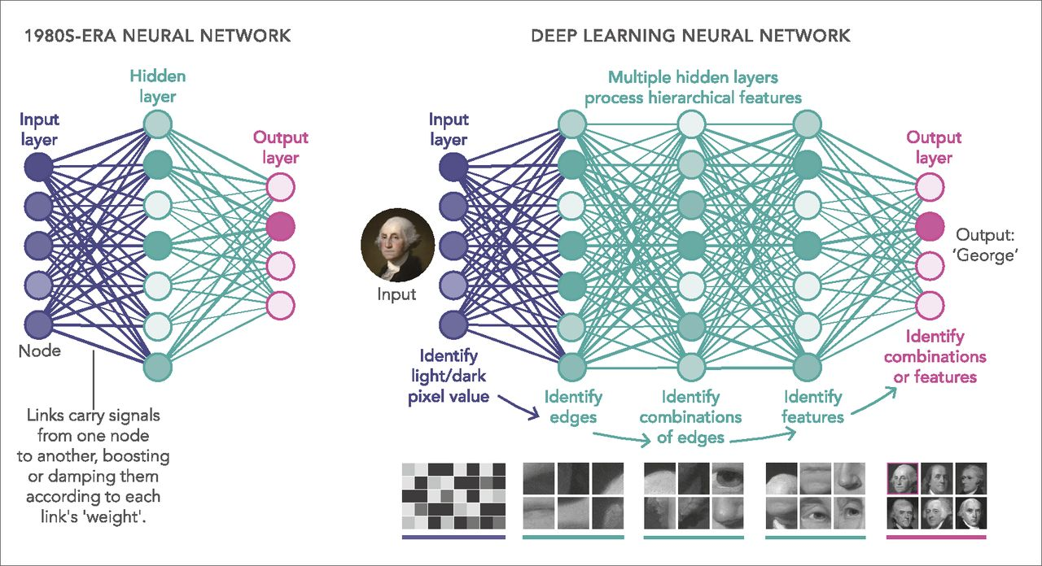
Deep Learning

Slide 17

Other advanced topics

Slide 18
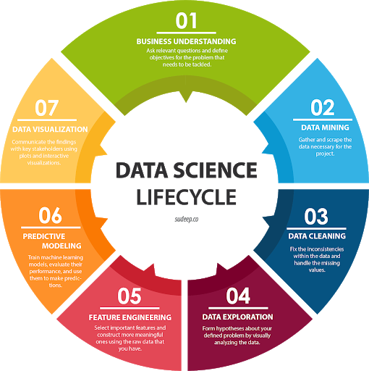
Data Science

Slide 19
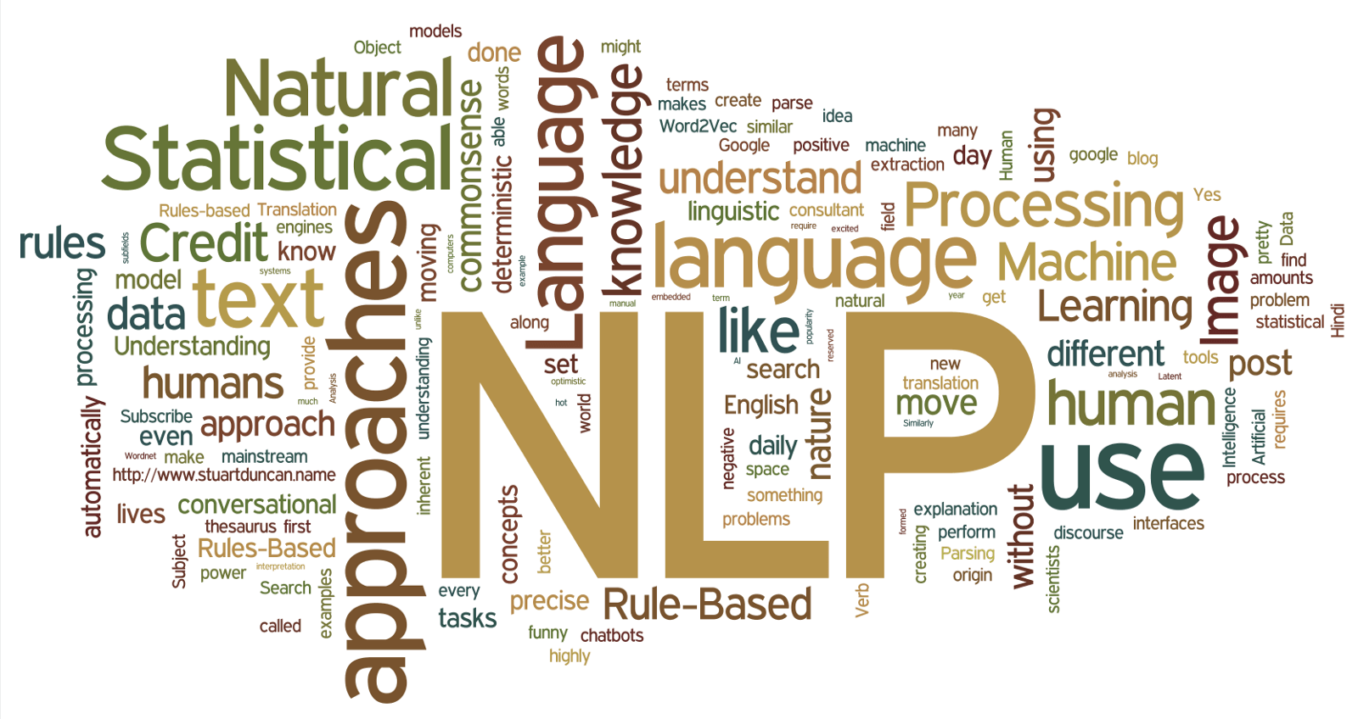
Natural Language Processing (NLP)
NLP is a field in computer science aimed at teaching computers to understand, analyze, manipulate,
and potentially generate human language.

Slide 20
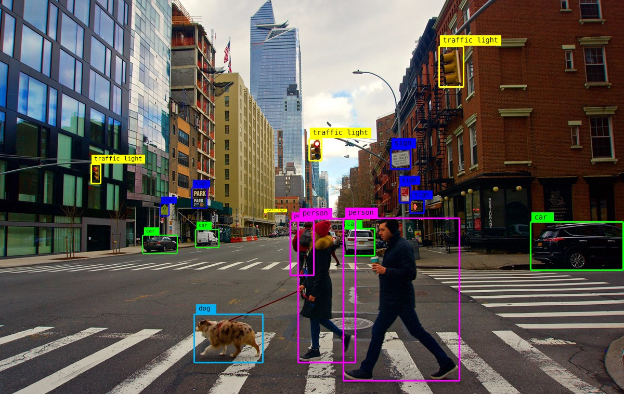

Computer Vision

Slide 21
Other Random Topics
Threading
Processing
Asynchronous programming
Decorators
Generators
Design Patterns
Architecture Styles & Patterns
Git
Continuous Integration
OS programming
Web Programming
Game Programming

